Slide 1
Support Vector Machine

Slide 2
Reading Assignment
Chapter 9 of the Introduction to Statistical Learning By Gareth James, et all

Slide 3
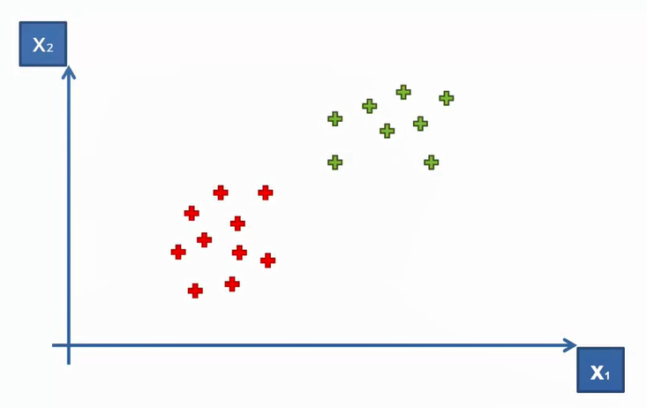
SVM Intuition
How to separate these points?

Slide 4
How to separate these points?
We can draw a separating hyperplane (or line if it’s only 2 dimension)

Slide 5
How to separate these points?

Slide 6
How to separate these points?

Slide 7
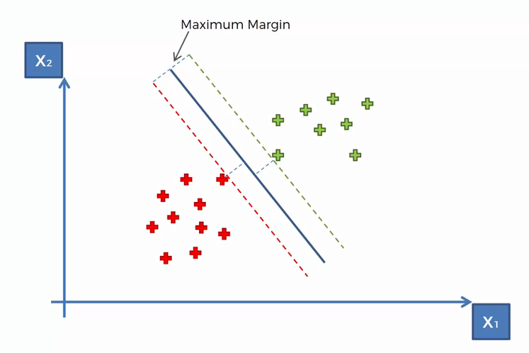
How SVM search for best line?
Line is searched through Maximum margin method

Slide 8
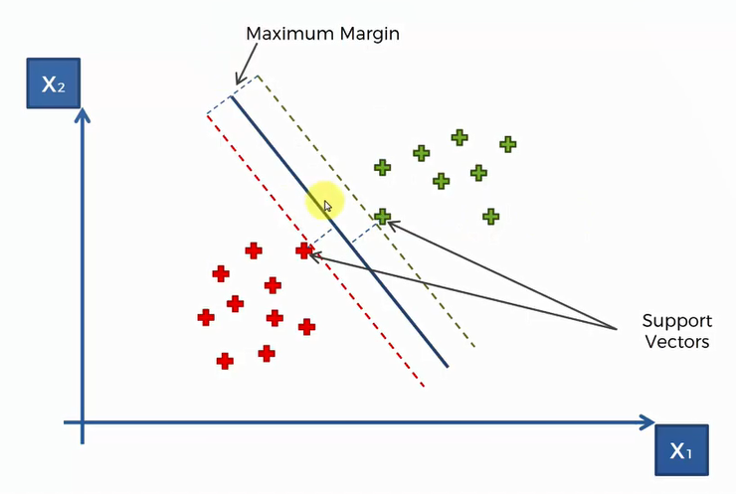
How SVM search for best line?
The closest point are called support vectors

Slide 9
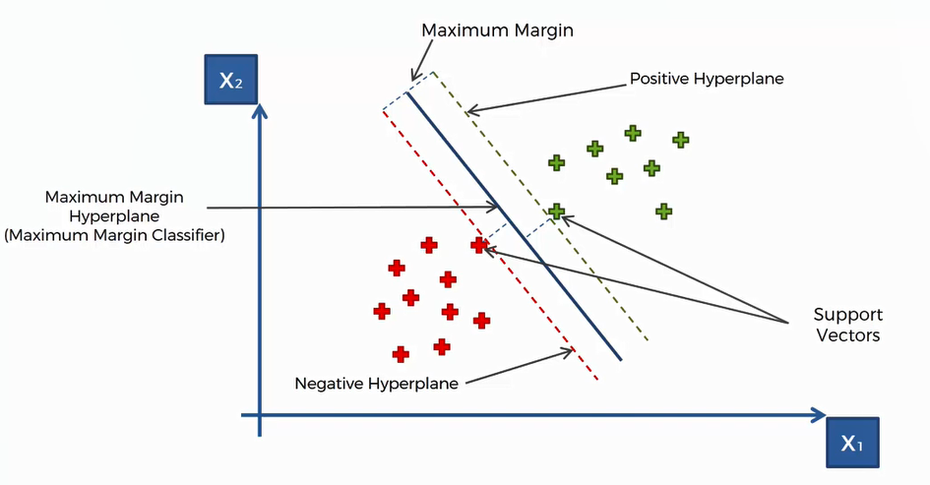
Hyperplanes

Slide 10
Kernel SVM Intuition

Slide 11
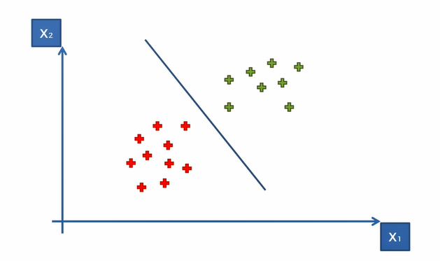
SVM Separates well these points

Slide 12
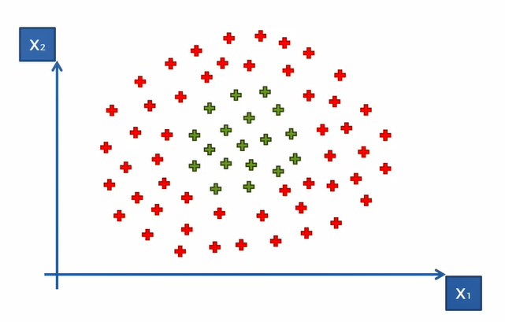
What about these points?
Data is not linearly separable

Slide 13
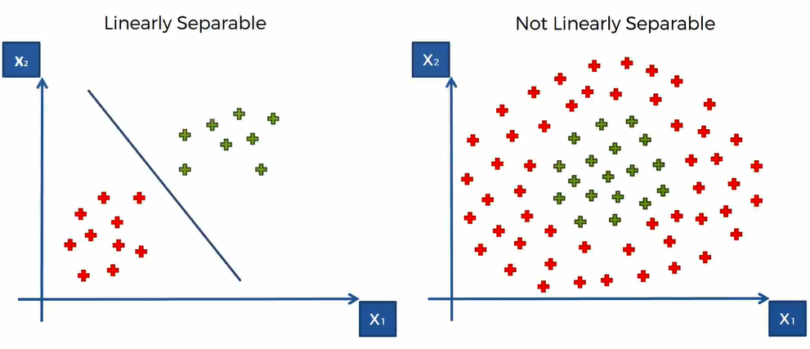
Linear Separability

Slide 14
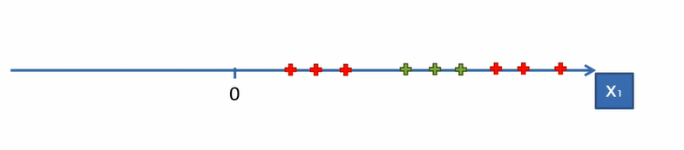
Mapping to a Higher Dimension
Example with single dimension
Clearly, not linearly separable

Slide 15
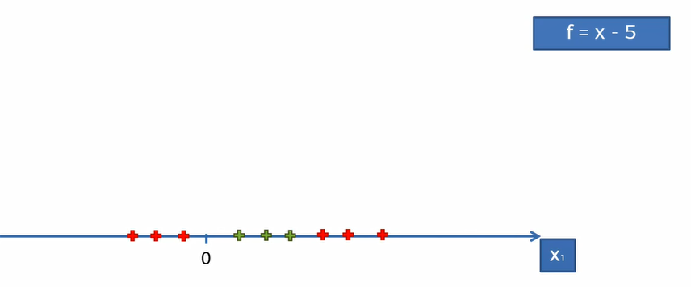
Mapping to a Higher Dimension
How we can apply the method of increasing the dimensionality of the space to make it linearly separable?

Slide 16
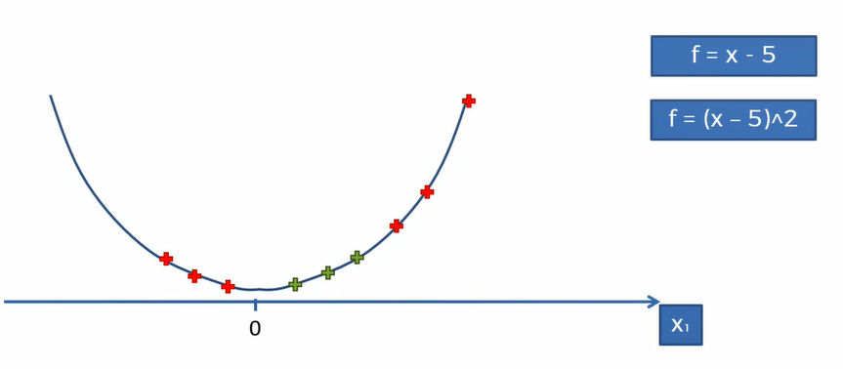
Mapping to a Higher Dimension
Square the function and project all points into it

Slide 17
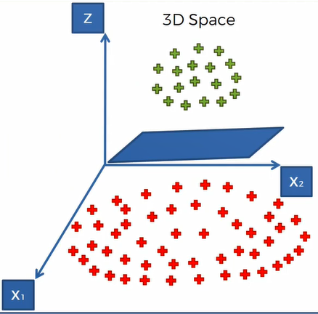
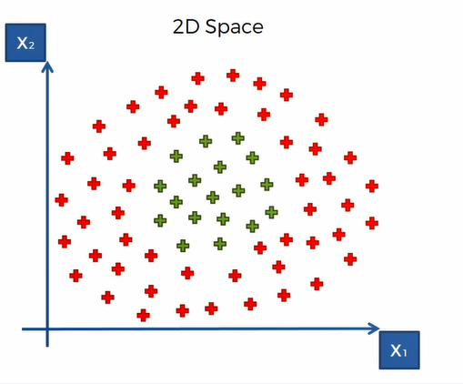
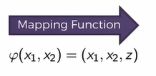
Mapping to a Higher Dimension
Example for 2 Dimension
New Dimension
Hyperplane

Slide 18
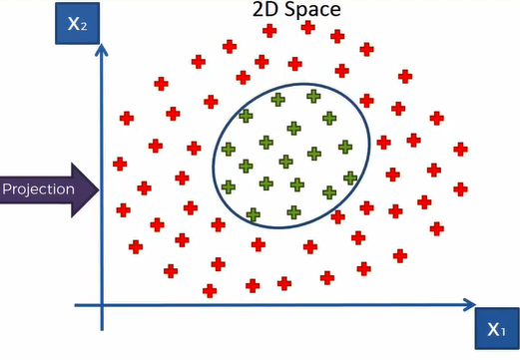
Projecting back to 2D Space
Non Linear separator

Slide 19
Problem with this Algorithm!
Mapping to a Higher Dimensional Space can be highly compute-intensive.
It may require lot of computation and lot of processing power if the data is large.
So what’s the best approach?

Slide 20
The Kernel Tricks!

Slide 21
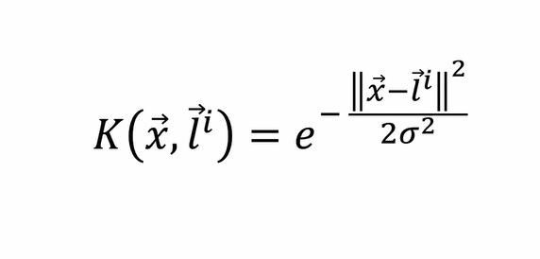
The Gaussian RBF Kernel
Radio basis function kernel

Slide 22
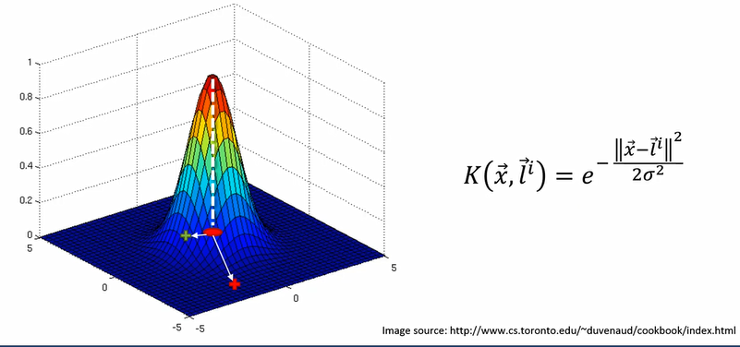
The Gaussian RBF Kernel

Slide 23
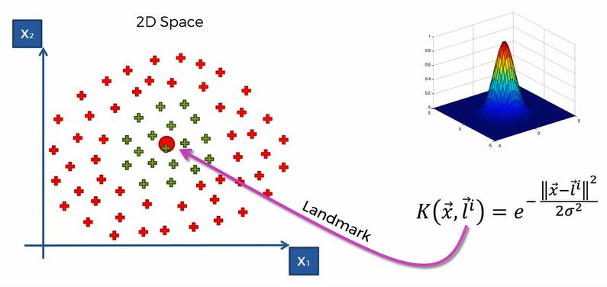
Why is it useful?

Slide 24
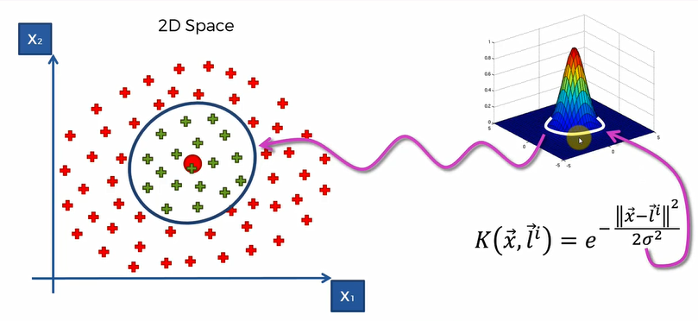
Why is it useful?

Slide 25
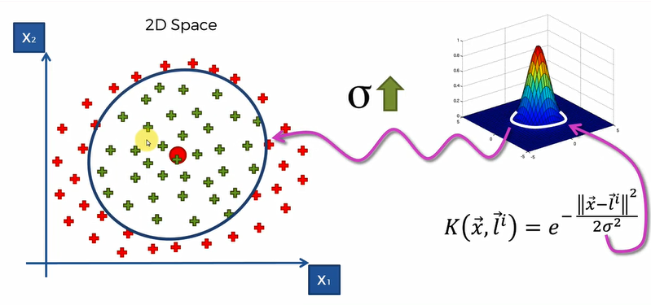
Kernel Trick!

Slide 26
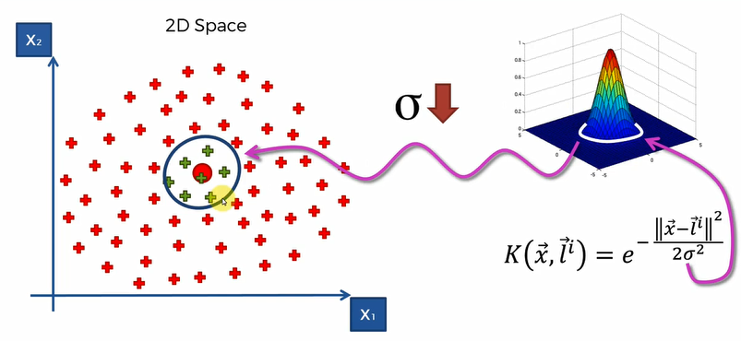
Kernel Trick!

Slide 27
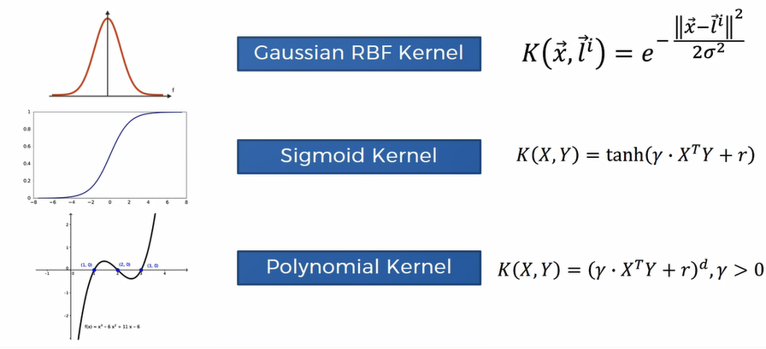
Types of Kernel function

Slide 28
Let’s get into action with python, see you in next lecture!

